Slide 1
The Ethical and Legal Implications of Information Systems Learning Objectives
Describe what the term information systems ethics means.
Explain what a code of ethics is and describe the advantages and disadvantages.
Define the term intellectual property and explain the protections provided by copyright, patent, and trademark.
Describe the challenges that information technology brings to individual privacy.

Slide 2
Ethics Definition
Textbook:
“A set of moral principles”
“The principles of conduct governing an individual or a group”
Merriam-Webster Collegiate Dictionary:
“The discipline dealing with what is good and bad and with moral duty and obligations”
“Involving or expressing moral approval or disapproval”
“Conforming to accepted professional standards of conduct”

Slide 3
Association for Computing Machinery (ACM) Code of Ethics Summary:
Commitment to ethical professional conduct is expected of every member (voting members, associate members, and student members) of the Association for Computing Machinery (ACM).

Slide 4
AIR Statement of Ethical Principles
The Association for Institutional Research affirms the following overarching principles regarding the use of data to facilitate insights and improve decision making. These principles guide us as we promote the use of data, analytics, information, and evidence to improve higher education.

Slide 5
AIR Statement of Ethical Principles
We act with integrity: We recognize the consequences of our work. The analytic algorithms and applications we build and/or implement, as well as the policy decisions incorporating information we analyze and disseminate, impact people and situations.
We acknowledge that the individuals whose information we use have rights, derived from both legal and ethical principles that can cross national borders. We make intentional efforts to protect their information from misuse or use that could cause them harm.
We protect privacy and maintain confidentiality when collecting, compiling, analyzing, and disseminating information.
We act as responsible data stewards.
We secure the data and information over which we have control, following generally accepted guidelines and professional standards for physical and electronic security and data sharing.
We provide accurate and contextualized information.
We do not knowingly or intentionally mislead the consumers of our information.

Slide 6
AIR Statement of Ethical Principles
We deliver information and analyses appropriate to the questions being asked, to the quality of the data available, and to the context in which the questions are asked.
We seek to be fair and transparent, minimizing our own personal biases in our research assumptions, methodologies, and conclusions.
We avoid conflicts of interest, and disclose them when unavoidable, particularly with third parties and vendors.
We act in the best interests of our institutions, students, and stakeholders. We strive to make our work accessible to those who need data, information, and analysis to generate insight and make decisions.
We share knowledge of the Institutional Research field and its application so we may facilitate insights and promote common understanding to our institutions and stakeholders.
We value lifelong learning and the enhancement of our field.
We draw on and contribute to relevant and emerging scholarship and educate ourselves on developing trends.
We utilize those methods and techniques for which we have, or can obtain, appropriate knowledge and capabilities.
We recognize that technological advancements have and will continue to impact our work.
We remain committed to serving as educators and role models on the ethical use of data to benefit students and institutions and to improve higher education.
Approved by the AIR Board of Directors September 13, 2019

Slide 7
Professional/Licensing Requirements
Many professions have stringent professional codes of ethics which are often regulated by licensing. These include:
Medical
Financial
Real Estate
Food Service
Legal
Education

Slide 8
Intellectual Property
Intellectual property is defined as “property (as an idea, invention, or process) that derives from the work of the mind or intellect.
In the US Constitution, Article 8, Section 8, the authors saw fit to recognize the importance of protecting creative works:
Congress shall have the power . . . To promote the Progress of Science and useful Arts, by securing for limited Times to Authors and Inventors the exclusive Right to their respective Writings and Discoveries.

Slide 9
Copyright
Copyright is the protection given to songs, computer programs, books, and other creative works. Any work that has an “author” can be copyrighted. Under the terms of copyright, the author of a work controls what can be done with the work, including:
• Who can make copies of the work.
• Who can make derivative works from the original work.
• Who can perform the work publicly.
• Who can display the work publicly.
• Who can distribute the work.
In the United States a copyright is obtained by the simple act of creating the original work.

Slide 10
The Digital Millennium Copyright Act
As digital technologies have changed what it means to create, copy, and distribute media, a policy vacuum has been created. In 1998, the US Congress passed the Digital Millennium Copyright Act (DMCA), which extended copyright law to take into consideration digital technologies. Two of the best-known provisions from the DMCA are the anti-circumvention provision and the “safe harbor” provision.

Slide 11
The Anti-Circumvention Provision
The anti-circumvention provision makes it illegal to create technology to circumvent technology that has been put in place to protect a copyrighted work. This provision includes not just the creation of the technology but also the publishing of information that describes how to do it. While this provision does allow for some exceptions, it has become quite controversial and has led to a movement to have it modified.

Slide 12
Safe Harbor Provision
The “safe harbor” provision limits the liability of online service providers when someone using their services commits copyright infringement. This is the provision that allows YouTube, for example, not to be held liable when someone posts a clip from a copyrighted movie. The provision does require the online service provider to take action when they are notified of the violation (a “takedown” notice). For an example of how takedown works, here’s how YouTube handles these requests: YouTube Copyright Infringement Notification.

Slide 13
Creative Commons
Creative Commons is a nonprofit organization that provides legal tools for artists and authors. The tools offered make it simple to license artistic or literary work for others to use or distribute in a manner consistent with the author’s intentions. Creative Commons licenses are indicated with the symbol. It is important to note that Creative Commons and public domain are not the same. When something is in the public domain, it has absolutely no restrictions on its use or distribution. Works whose copyrights have expired are in the public domain. By using a Creative Commons license, authors can control the use of their work while still making it widely accessible.

Slide 14
Patents
Patents are another important form of intellectual property protection. A patent creates protection for someone who invents a new product or process. The definition of invention is quite broad and covers many different fields. Here are some examples of items receiving patents:
• circuit designs in semiconductors
• prescription drug formulas
• firearms
• locks
• plumbing
• engines
• coating processes
• business processes

Slide 15
Obtaining Patent Protection
A patent will only be granted if the invention or process being submitted meets certain conditions:
• Must be original. The invention being submitted must not have been submitted before.
• Must be non-obvious. You cannot patent something that anyone could think of. For example, you could not put a pencil on a chair and try to get a patent for a pencil-holding chair.
• Must be useful. The invention being submitted must serve some purpose or have some use that would be desired.

Slide 16
Trademark
A trademark is a word, phrase, logo, shape or sound that identifies a source of goods or services. For example, the Nike “Swoosh,” the Facebook “f”, and Apple’s apple (with a bite taken out of it) are all trademarked. The concept behind trademarks is to protect the consumer.
Two types of trademarks exist – a common law trademark and a registered trademark. As with copyright, an organization will automatically receive a trademark if a word, phrase, or logo is being used in the normal course of business (subject to some restrictions, discussed below). A common law trademark is designated by placing “TM” next to the trademark. A registered trademark is one that has been examined, approved, and registered with the trademark office, such as the Patent and Trademark Office in the US. A registered trademark has the circle-R (®) placed next to the trademark.

Slide 17

What is this?

Slide 18
Privacy
The term privacy has many definitions, but for purposes here, privacy will mean the ability to control information about oneself. The ability to maintain our privacy has eroded substantially in the past decades, due to information systems.

Slide 19
Personally Identifiable Information
Information about a person that can be used to uniquely establish that person’s identify is called personally identifiable information, or PII. This is a broad category that includes information such as:
• Name• Social Security Number; • Date of birth; • Place of birth; • Mother‘s maiden name; • Biometric records (fingerprint, face, etc.); • Medical records; • Educational records; • Financial information; and • Employment information.
Organizations that collect PII are responsible to protect it. The Department of Commerce recommends that “organizations minimize the use, collection, and retention of PII to what is strictly necessary to accomplish their business purpose and mission.”

Slide 20
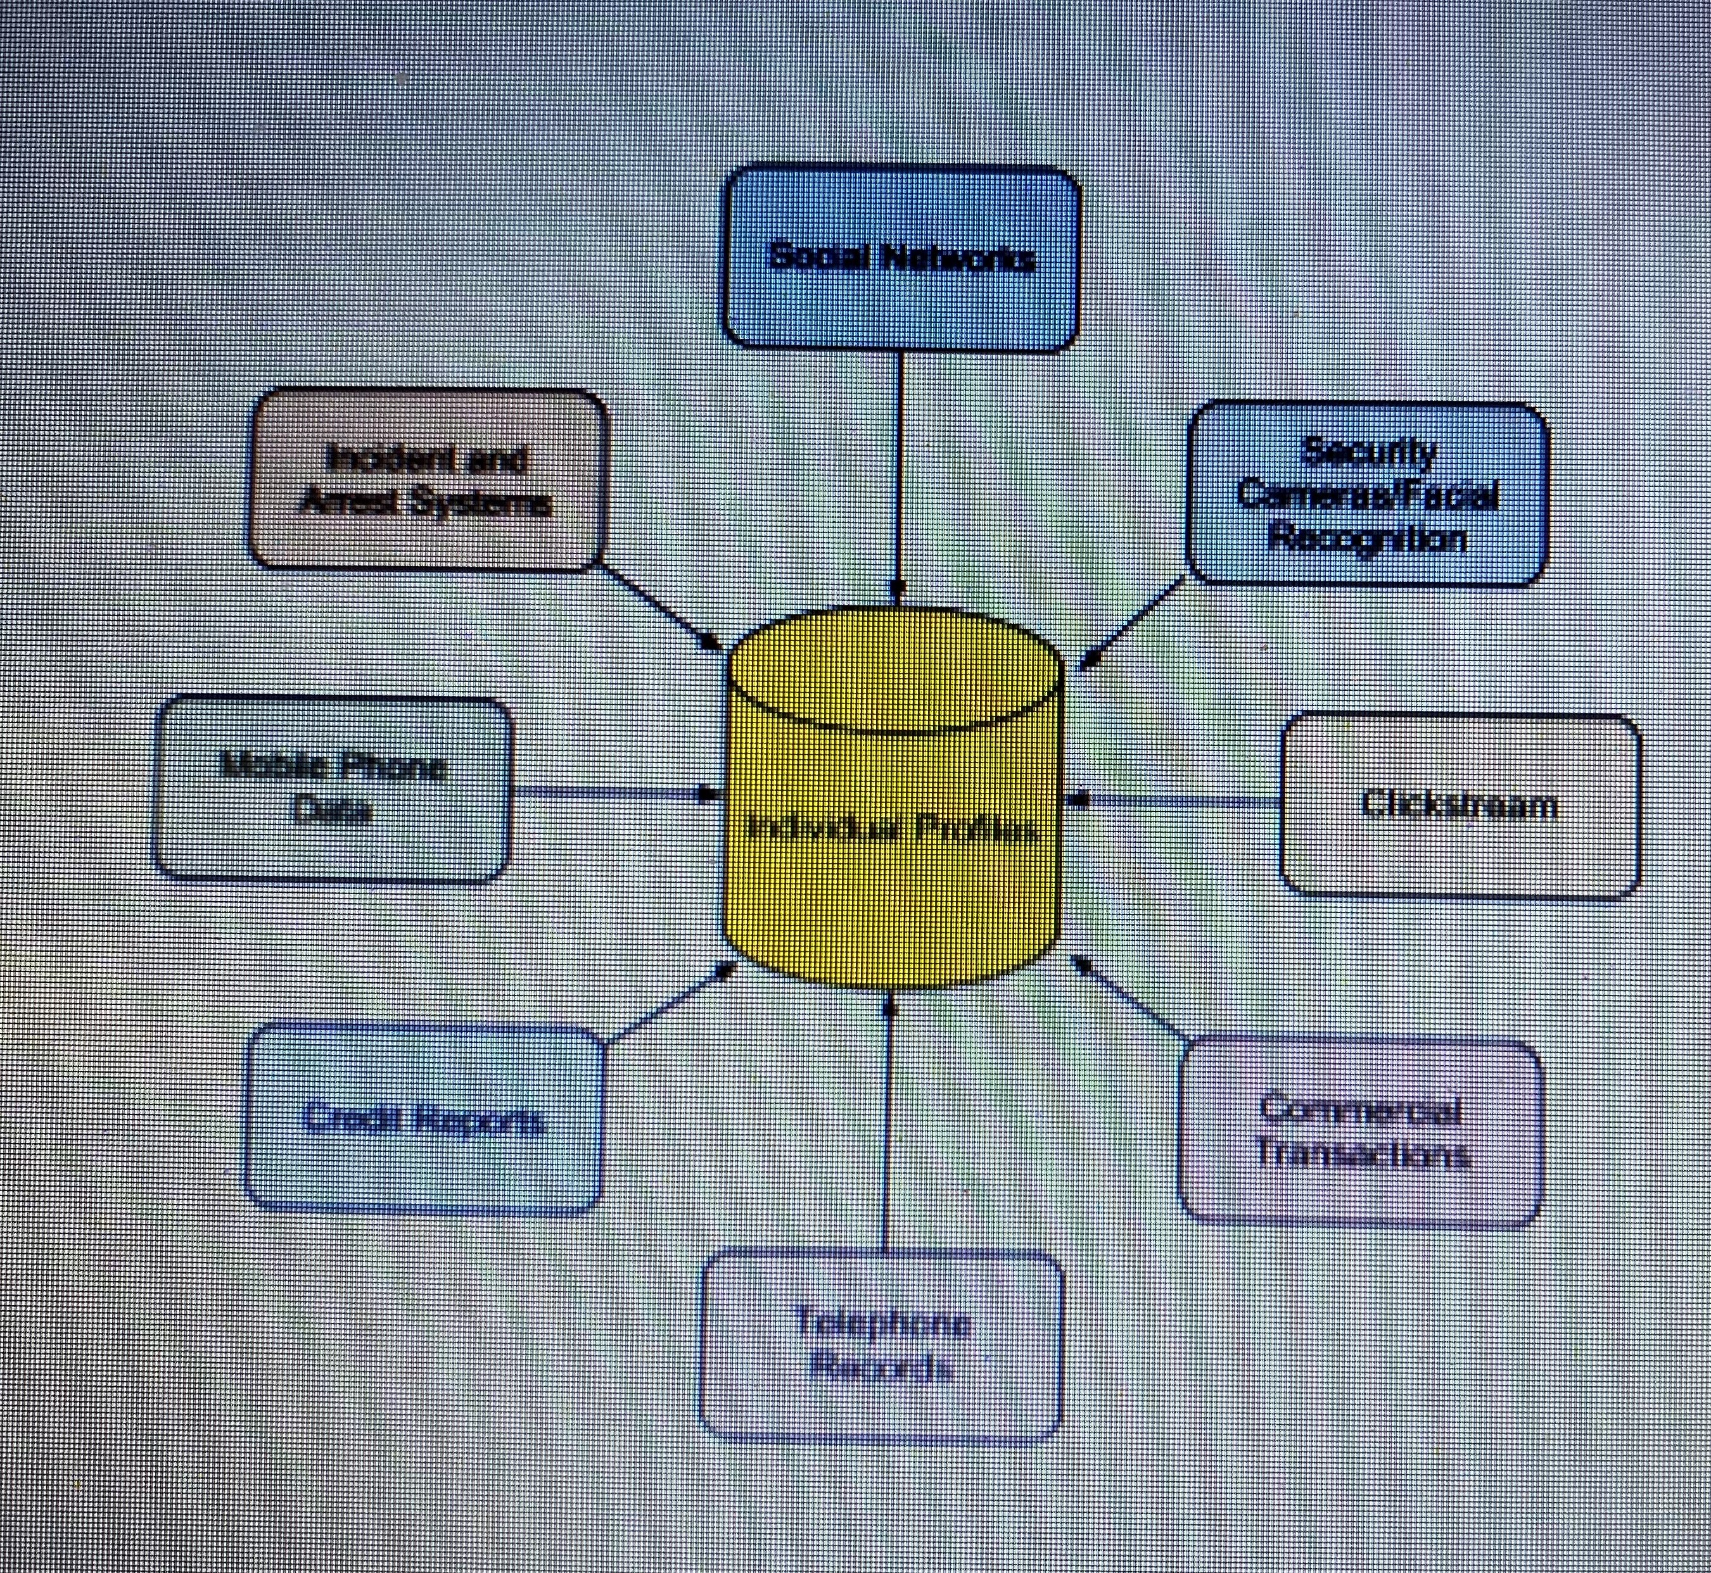
Non-Obvious Relationship Awareness

Slide 21
Restrictions on Data Collecting
Children’s Online Privacy Protection Act
Family Educational Rights and Privacy Act
Health Insurance Portability and Accountability Act
General Data Protection Regulation

Slide 22
Do Not Track Regulations
When it comes to getting permission to share personal information, the US and the EU have different approaches. In the US, the “optout” model is prevalent. In this model the default agreement states that you have agreed to share your information with the organization and must explicitly tell them that you do not want your information shared. There are no laws prohibiting the sharing of your data, beyond some specific categories of data such as medical records. In the European Union the “opt-in” model is required to be the default. In this case you must give your explicit permission before an organization can share your information.

Slide 23
Washington Post, “When you “Ask app not to track,” some iPhone apps keep snooping anyway” Sunday, April 17, 2022
“When it comes to stopping third-party trackers, App Tracking Transparency is a dud. Worse, giving users the option to tap an ‘Ask App Not To Track’ button may even give users a false sense of privacy,” said Lockdown co-founder Johnny Lin, a former Apple iCloud engineer.

Slide 24
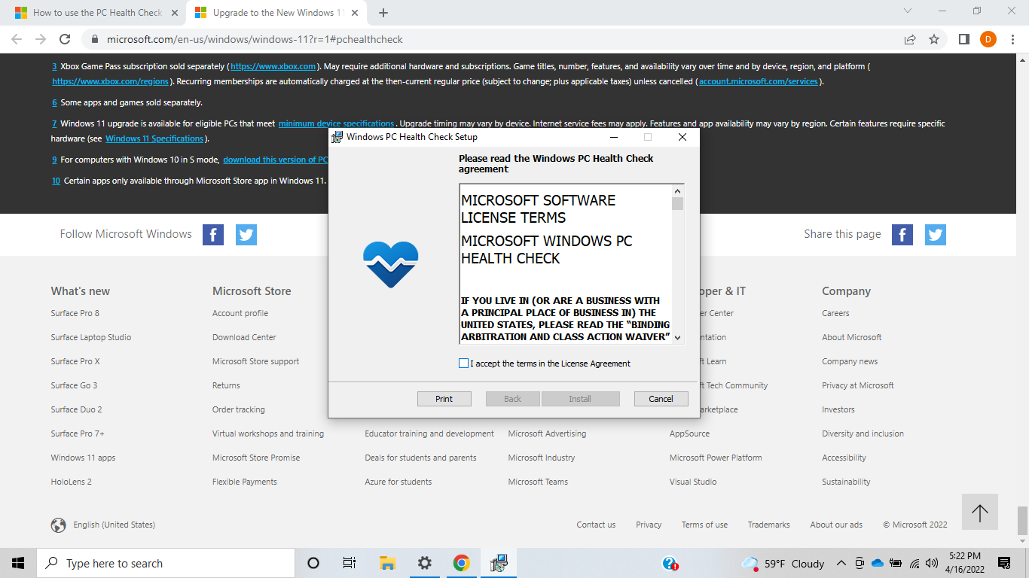

Slide 25
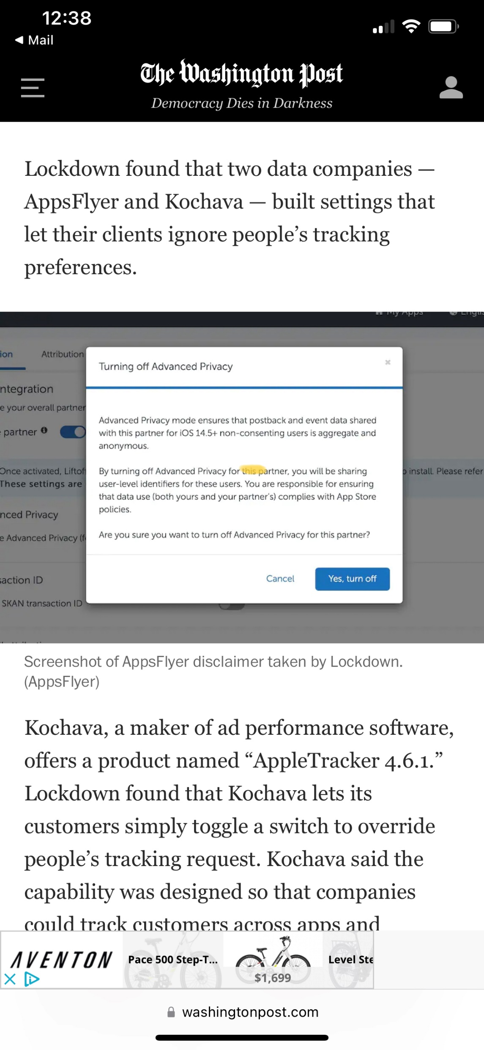

Slide 26
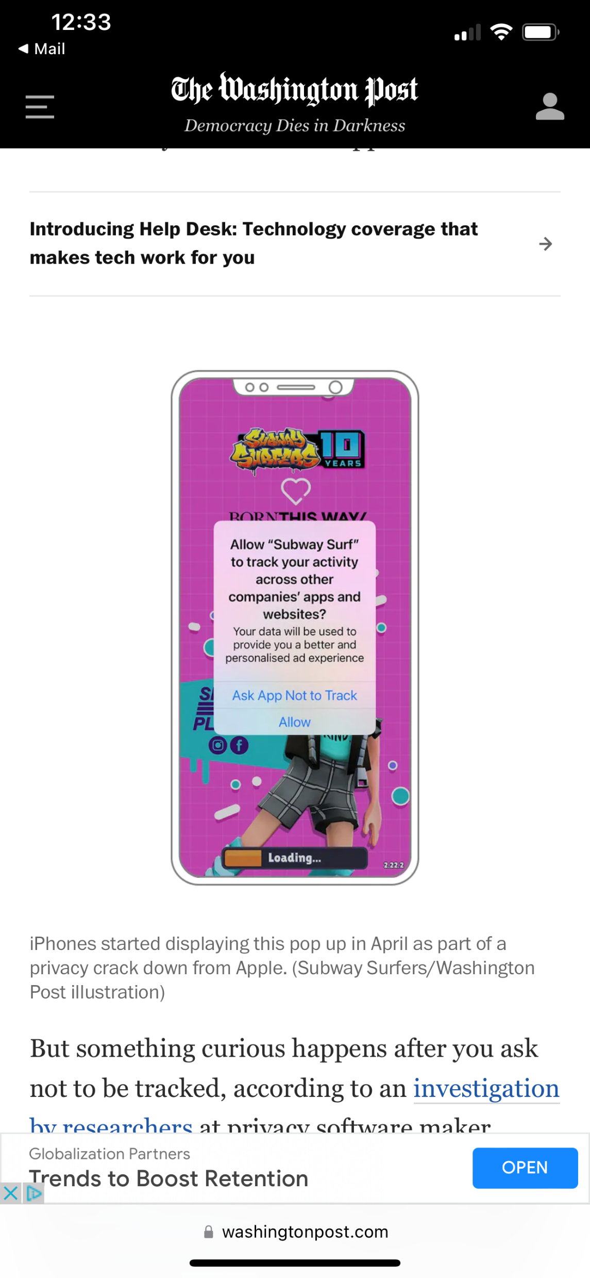

Slide 27
Data shared with Chartboost by ‘Subway Surfers’, ‘Streamer Life!’ and ‘Run Rich 3D’ Source Washington Post, Sunday, April 17, 2022
Device Name (e.g. John’s iPhone X”)
Accessibility Setting: Bold Text
Accessibility Setting: Custom Text Size
Display Setting: Dark Mode
Screen Resolution
Time Zone
Total Storage Space (bytes precision)
Free Storage Space (bytes precision)
Currency (e.g. “USD”)
iOS Version
Audio Output (e.g. “Speakerphone”/””Bluetooth”)
Audio Input (e.g. “iPhone Microphone”)
Accessibility Setting: Closed Captioning
Country
Cellular Carrier Name (e.g. “AT & T”)
Cellular Carrier Country
Last Restart Time (Exact Timestamp, Second Precision)
Calendar Type (e.g. “Gregorian”)
Enabled Keyboards (e.g. “English, Emoji, Arabic”)
Current Battery Level (15 decimals precision)
Current Volume Level (3 decimal precision)
Accessibility Setting: Increase Contrast
Current Screen Brightness (15 decimals precision)

Slide 28
Data shared with Chartboost by ‘Subway Surfers’, ‘Streamer Life!’ and ‘Run Rich 3D’
Portrait/Landscape Mode
Battery Charging State (e.g. “Plugged In”)
iPhone Model (e.g. “iPhone X”)
Language
User Agent (Browser Agent)
IP address

Slide 29
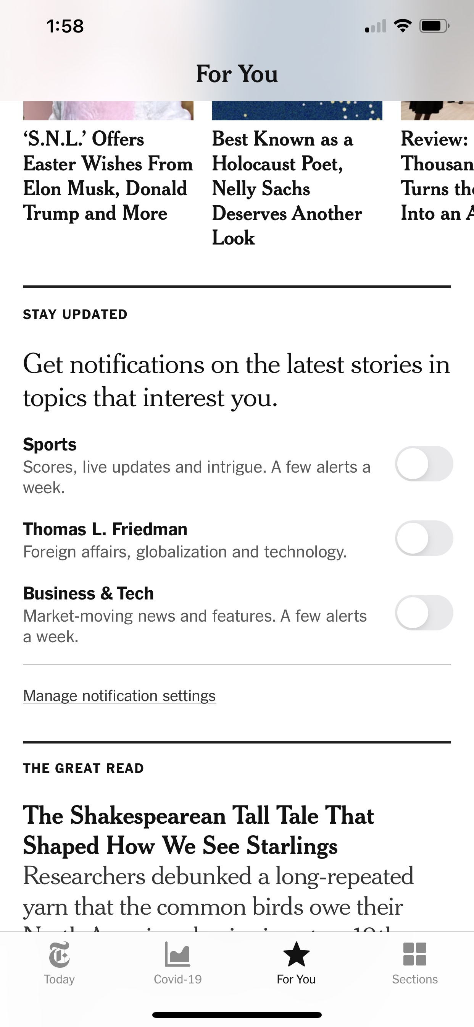

Slide 30
Turbo Tax

Slide 31
Responding to dubious messages and emails

Slide 32
Serenity Prayer
God grant me the serenity to accept the things I cannot change, the courage to change the things I can, and the wisdom to know the difference.
Source: There is no definitive source for the Serenity Prayer which originated in the first half of the 20th Century.

Slide 33
What’s All This Mean to You?

